Slide 1


AIRLINE SUPPORT BOT – INTELLIGENT INTENT CLASSIFICATION SYSTEM
Team 14 : Code Crew
Catherine Mary - 22N211
Sakthi S - 22N245
Subiksha - 22N259

Slide 2
PROBLEM STATEMENT 1
In the airline industry, identifying customer issues at an early stage is essential to ensure smooth and efficient service. Customers often ask similar types of questions related to cancellations, luggage, seat availability, and other common concerns. To handle these requests effectively, there is a need for a system that can automatically classify a customer’s message into the appropriate request type as soon as it is received. Such a system would allow faster and more accurate responses, enhancing the overall user experience. Moreover, the system should have the ability to learn from its mistakes through feedback, gradually improving its accuracy and understanding of customer intents over time.

Slide 3

OUR SOLUTION
Our solution is an intelligent airline support chatbot that classifies customer messages into the correct request type using machine learning. It is built with Python and Streamlit for an interactive interface, and MongoDB is used to store intents, example utterances, and feedback. The system uses a Sentence Transformer model to understand the meaning of customer queries and find the most relevant intent based on semantic similarity. It can handle multiple intents, identify irrelevant queries, and continuously learn from user feedback to improve its accuracy over time.

Slide 4

TECH STACK
Programming Language: Python
Frontend / UI Framework: Streamlit
Machine Learning Model: Sentence Transformer (all-MiniLM-L6-v2)
Database: MongoDB
Libraries Used: PyTorch, Sentence-Transformers, Pymongo, Torch, Util
Approach: Semantic similarity-based intent classification

Slide 5
Component | Description
User Interface (CLI/Chat) | Accepts user input and displays classification + response.
Sentence Transformer Model | Converts text into numerical embeddings using semantic similarity.
Intent Database (MongoDB) | Stores intents, example utterances, and user feedback.
Similarity Engine | Calculates cosine similarity between user input and stored examples.
Feedback Module | Records feedback and updates training data.
Continuous Learning Pipeline | Dynamically updates embeddings and improves model performance.

Slide 6
DATASET
Initial Data: Small set of example utterances for each intent.
Stored in MongoDB for easy expansion.
18+ request types (e.g., Cancel Trip, Flight Status, Missing Bag, Discounts).
Includes “Irrelevant” category for out-of-domain inputs.

Slide 7
SENTENCE TRANSFORMER
Understand the meaning of sentences, not just individual words
Convert sentences into vector embeddings
Semantically similar sentences → closer vectors in embedding space
Built using models like BERT
Used for semantic search, clustering, and intent classification
Helps systems recognize different ways of expressing the same idea

Slide 8
MODEL WORKFLOW
User message → encoded using SentenceTransformer (‘all-MiniLM-L6-v2’).
Similarity computed with each intent’s example embeddings using cosine similarity.
Top-K intents selected above threshold (e.g., 0.6).
Response displayed to user.
Feedback collected → model updated dynamically.

Slide 9
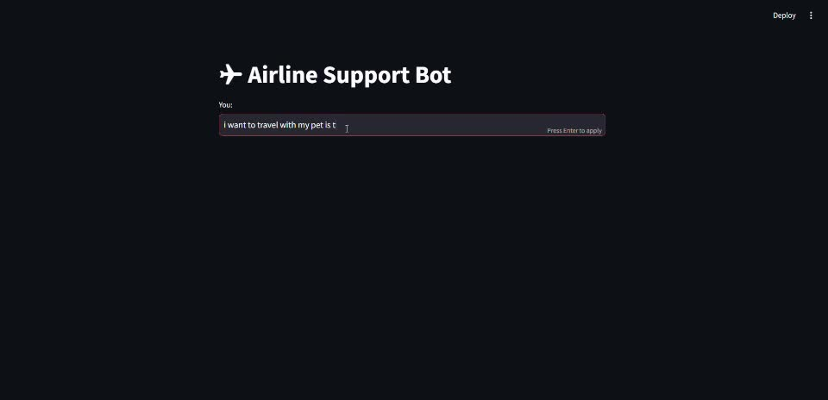
DEMO

Slide 10
FUTURE ENHANCEMENTS
Entity Extraction & Slot Filling: Use extracted entities (dates, flight numbers) to trigger actions automatically.
Personalized Responses: Tailor replies using user history and preferences.
Fallback to LLM: Use Gemini API for ambiguous or complex queries beyond predefined intents.
Rich Responses: Enhance replies with links, buttons, or attachments.
Scalability: Deploy on cloud platforms (AWS, GCP) to handle multiple users concurrently.

Slide 11
THANK YOU!

